Slide 1

Case Study google course
How can a wellness technology Company play it
smarts?
Data set is public on Kaggle (FitBit Fitness Tracker Data)

Slide 2
Aim of the analysis
Get insights about the data and the trends on it to apply it to Bellabeat customers
1
Use the trends to improve the products and use this features to influence Bellabeat marketing strategy
2

Slide 3
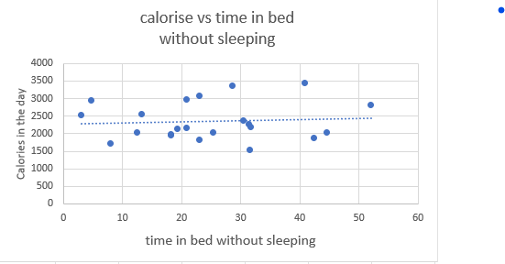
Sleep in the day
Users spend around 40 minutes in bed without sleeping
There is no relation between Time spend in the bed without sleeping and The amount of calories they burned in the day
RECOMMENDATION :
Add sleep reminder for the device to remind the
user to sleep after he gets in the bed

Slide 4
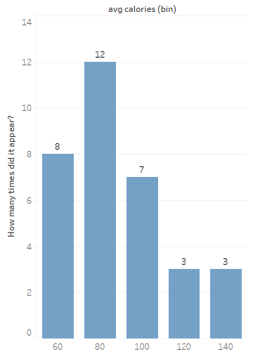
Some insights
Average calories per hour
Average number of steps per day for a user is 7600 and this value is less than the recommended value which is 10000 so I recommend add target of 10000 steps that the user can achieve to encourage him to walk more.
Average number of calories burned by users is 2300 which is good
Average of calories per hour for users is 95 with minimum 62 and maximum 144 and in most cases calories happened to be between 80 – 100 per hour

Slide 5
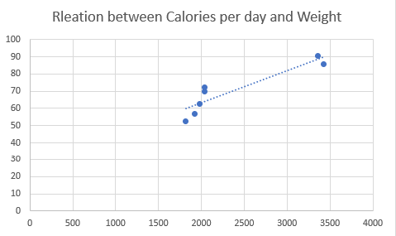
Weight and bmi
Average of BMI is 24 which is slightly high but it is in the healthy range
There is a direct relationship between the user’s weight and the amount of calories burned per day
Weight
Recommendation :
Add feature in the device to tell the user
the recommended calories to burn in the day
that depend on the Weight or BMI
Calories burned per day

Slide 6
Summary of recommendations
Add sleep reminder for the device to remind the user to sleep after he gets in the bed
add target of 10000 steps that the user can achieve to encourage him to walk more
Add feature in the device to tell the user the recommended calories to burn in the day that depend on the Weight or BMI

